Slide 2
Embedded Systems IAY0330 Project: Fishfeeder
Kätlin Lahtvee, Aivar Koodi
Sander Sinijärv, Martin Grosberg
Marek Aare

Slide 3
Objective
Autonomous aquarium
Temperature
Light
Feeding system
Filter cleaning reminder
Water level

Slide 4
System Architecture
Power supply
MSP430 #2
Server
MSP430 #1
RF communication shield
Temperature sensor
Light sensor
Motor
Feed level sensor
Water level sensor

Slide 5
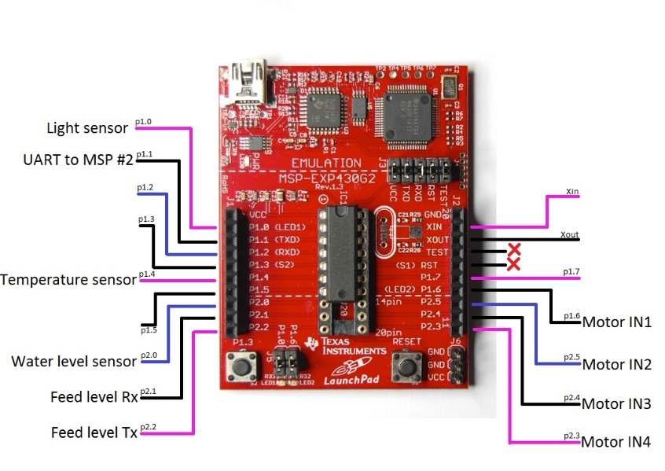
Wiring diagram

Slide 6
Data exchange with server
Data to send to server
Light sensor data
Temperature sensor data
Water level sensor data
Feed level sensor data
Filter cleaning necessity
Data to receive from server
Clock

Slide 7
Component description
TI MSP 430 launchpad
868MHz wireless connection shield
Light sensor
Feeding system (Auger)
Feed level sensors
Stepper motor + driver
Temperature sensor
Water level sensor

Slide 8
Assignements finished
Light sensor is functional
Temperature sensor is functional
Water level sensor is functional
UART connection between MSP430 boards established
Most of materials for fishfeeder gathered

Slide 9
Issues
How to establish connection to server
How to write all functionalities in one code
How to 3D print needed components
How to provide power for sensors, motor and LEDs.

Slide 10
Project Organisation
Building feeder system-Kätlin/Aivar
Attaching feeding system
Implementing level sensor
Building feedtank
Programming
Implementing and programming lighting sensor- Sander
Implementing and programming temperature sensor- Aivar
Implementing and programming water level sensor- Martin
Implementing and programming feed level sensor- Sander
Establis connection between MSP430- Marek
Establis connection to main server- Marek/Martin

Slide 11
Working Plan
S6 – hardware ordering
S7 – working out the system architecture
S8 – S14 – programming and building the device
S15 – working solution
S16 – final project presentation

Slide 12
Cost calculation
stepper motor + driver (Already bought)
Feeder level sensor (Already bought)
Aquarium (Provided by course)
Light sensor (Already bought)
Temperature sensor 10 €
Water level sensor (Provided by course)
TI launchpad (Provided by course)
Radio module (Provided by course)
3D printing service 10€
Power 12V supply 10€
FINAL COST 30 €

Slide 13
Thank you!

